Slide 2

Philipp Fehre
Twitter: @ischi
Github: @sideshowcoder
Developer Advocate, Couchbase
Notes:
- Been doing node.js since some time and C longer

Slide 3


Notes:
Founders were users and contributers to memcached
They build membase -> make memcache persistent and useable as a Database
Merge with Couchone to build Couchbase

Slide 4

Couchbase Server Core Principles
Easy Scalability
Consistent High Performance
Grow cluster without application changes, without downtime with a single click
Consistent sub-millisecond read and write response times with consistent high throughput
Always On 24x365
Flexible Data Model
No downtime for software upgrades, hardware maintenance, etc.
JSON Anywhere document model with no fixed schema.

Slide 5
Couchbase Server 2.0 Architecture
8092
Query API
11211
Memcapable 1.0
11210
Memcapable 2.0
Moxi
Query Engine
Memcached
Couchbase EP Engine
REST management API/Web UI
Data Manager
Cluster Manager
Heartbeat
Process monitor
vBucket state and replication manager
Rebalance orchestrator
Configuration manager
Node health monitor
Global singleton supervisor
storage interface
New Persistence Layer
http
on each node
one per cluster
Erlang/OTP
HTTP
8091
Erlang port mapper
4369
Distributed Erlang
21100 - 21199

Slide 6
Couchbase Server 2.0 Architecture
8092
Query API
11211
Memcapable 1.0
11210
Memcapable 2.0
RAM Cache, Indexing & Persistence Management
(C)
Server/Cluster Management & Communication
(Erlang)
Moxi
Query Engine
Object-level Cache
Couchbase EP Engine
REST management API/Web UI
Process monitor
Heartbeat
Configuration manager
Node health monitor
Global singleton supervisor
Rebalance orchestrator
vBucket state and replication manager
storage interface
New Persistence Layer
Disk Persistence
http
on each node
one per cluster
Erlang/OTP
HTTP
8091
Erlang port mapper
4369
Distributed Erlang
21100 - 21199

Slide 7
Couchbase Organization
Couchbase operates like a Key-Value Document Store
Key is a UTF-8 string up to 256 Bytes
Values can be:
Simple Datatypes: strings, numbers, datetime, boolean, and binary data can be stored -- they are stored as Base64 encoded strings
Complex Datatypes: dictionaries/hashes, arrays/lists, can be stored in JSON format (simple lists can be string based with delimiter)
JSON is a special class of string with a specific format for encoding simple and complex data structures
Schema is unenforced and implicit, schema changes are programmatic, done online, and can vary from Document to Document

Slide 8
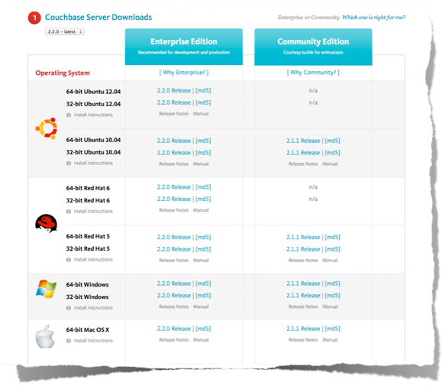




Download Couchbase
www.couchbase.com/download

Slide 9
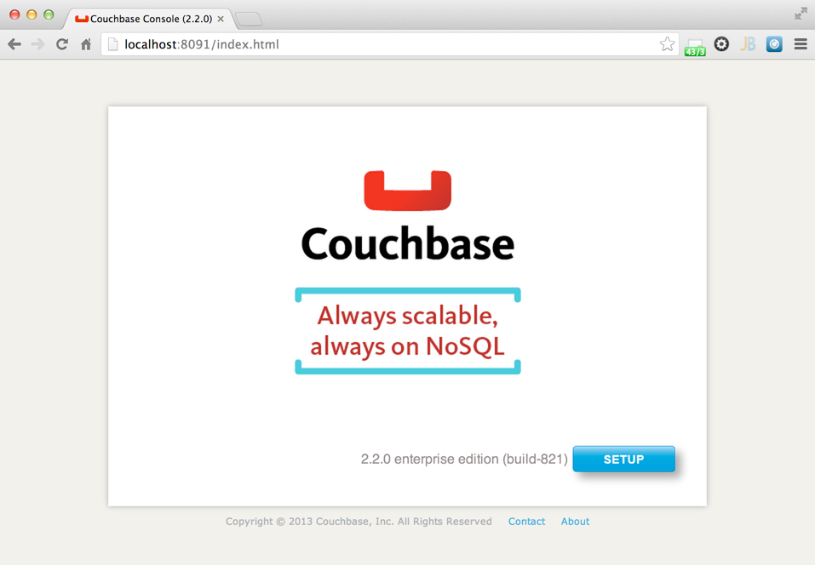
Run Couchbase and Open Browser
localhost:8091

Slide 10
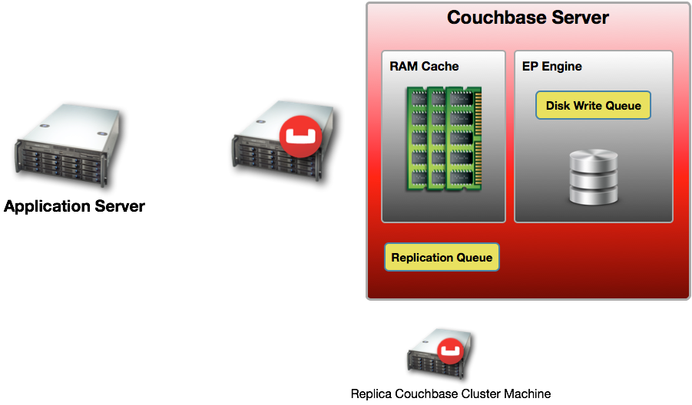
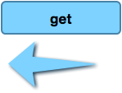

Retrieval Operations

Slide 11
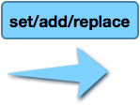




Storage Operations

Slide 12
Consistency

Slide 13
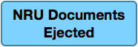
Ejection, NRU, Cache Miss
Non-Resident Document
("Cache Miss")
FULL (90%)

Slide 14
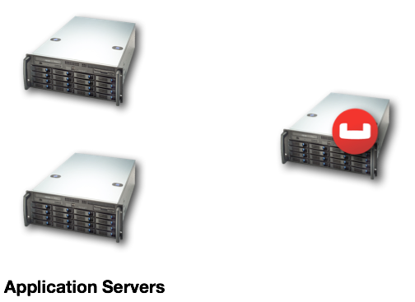


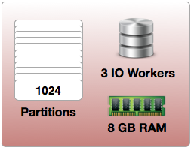
Clients Connect Directly to Couchbase Nodes

Slide 15
Key Hash-Partitioning
ClientHashFunction(”philipp@couchbase.com") => Partition[0..1023] {25}
ClusterMap[P(25)] => [x.x.x.x] => IP of Server Responsible for Partition 25

Slide 16
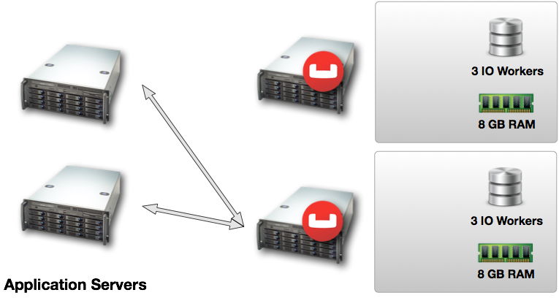
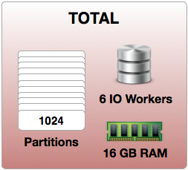



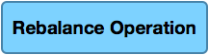
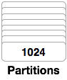
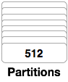
Horizontal Scale-Rebalance

Slide 17
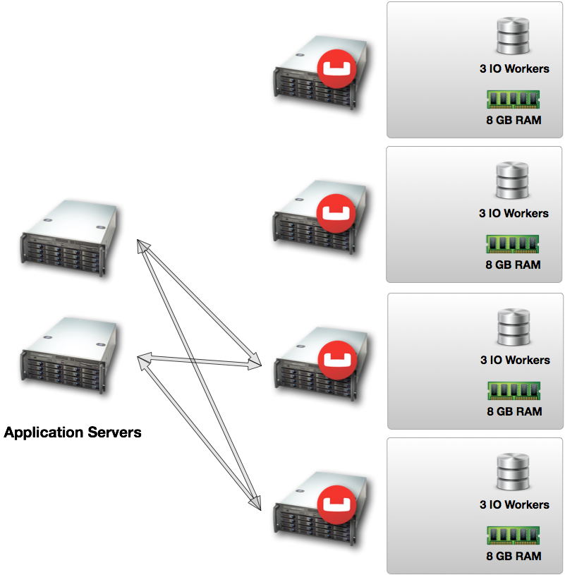


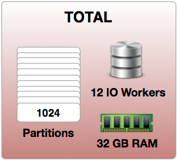

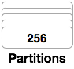
Horizontal Scale-Rebalance

Slide 18
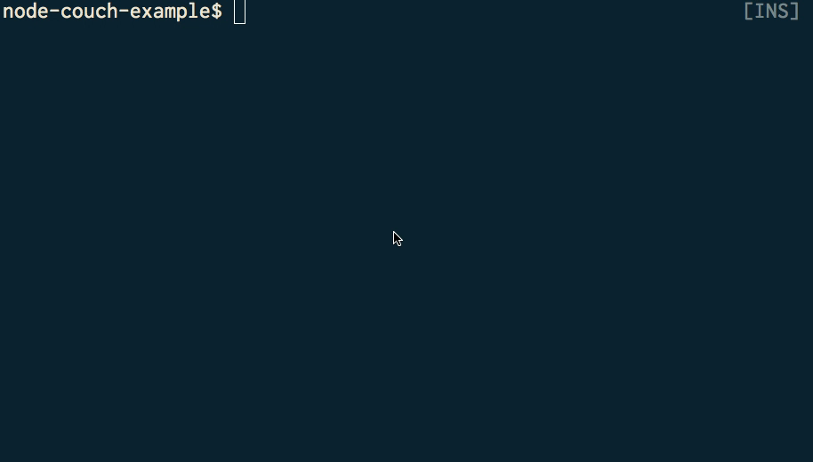
Notes:
Lets see it in action
Cool nothing special except cas

Slide 19

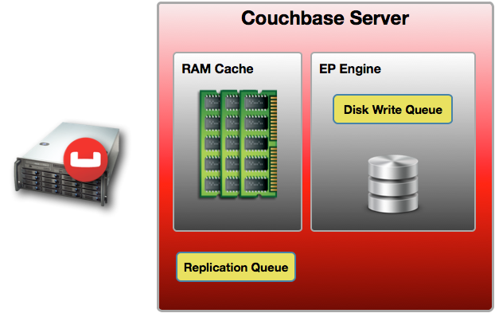
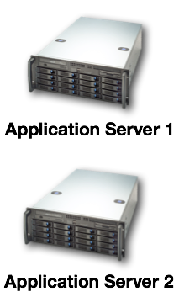
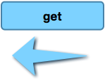
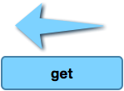
Optimistic Concurrency with CAS
CAS: 111111111
CAS: 111111111

Slide 20
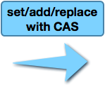
Optimistic Concurrency with CAS
CAS: 222222222
CAS: 111111111
CAS: 111111111

Slide 21
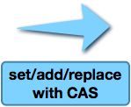
Optimistic Concurrency with CAS
CAS: 222222222
CAS MISMATCH
CAS: 111111111

Slide 22
Optimistic Concurrency with CAS
CAS: 222222222
NEW CAS GENERATED
RETRY MUTATION WITH UPDATED CAS
CAS: 222222222
CAS: 111111111

Slide 23
Optimistic Concurrency with CAS
CAS: 222222222
CAS: 333333333
CAS: 222222222
CAS: 333333333

Slide 24
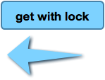
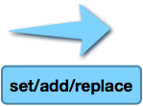
Pessimistic Concurrency with Lock
UNLOCKS AFTER COMPLETE
NEW CAS GENERATED
FAILS

Slide 25
WHAT IS A VIEW?

Slide 26
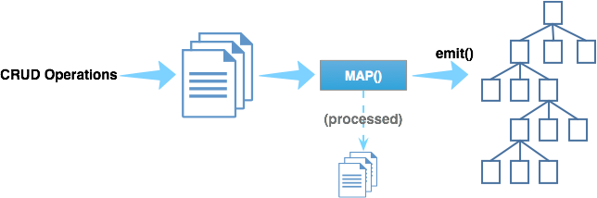
Views: Map-Reduce Indexes
In Couchbase, Map-Reduce is specifically used to create Indexes
Map functions are applied to JSON documents and they output or "emit" data that is organized in an Index form

Slide 27





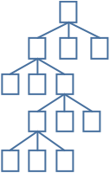
Sample View
function (doc, meta) {
if (doc.type == “beer” && doc.brewery_id && doc.name) {
emit(doc.name, doc.abv);
}
}

Slide 28
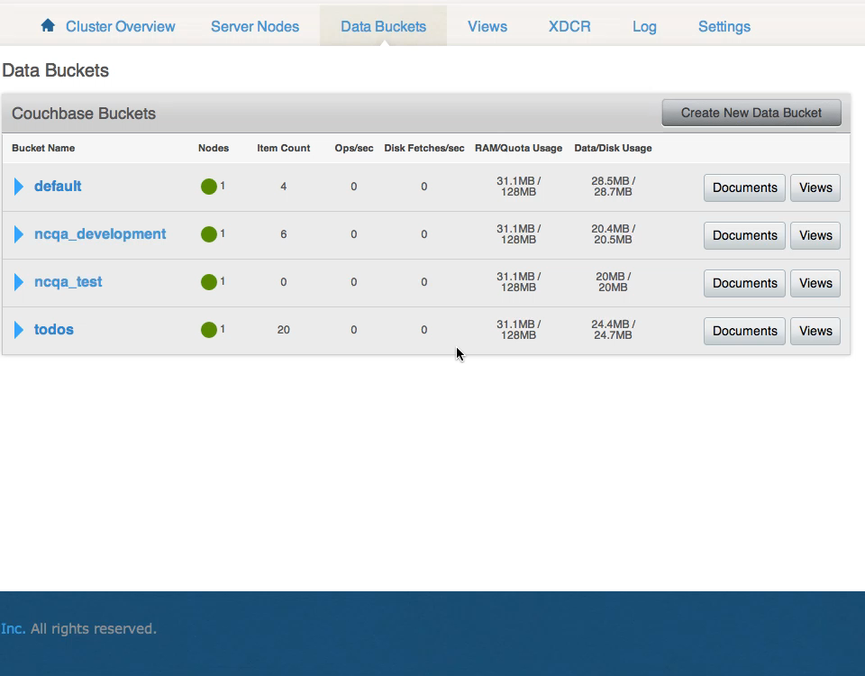
Notes:
Cool so we can create functions to index

Slide 29
SETUP SDK

Slide 30

Supported SDK's
www.couchbase.com/communities
Each supported SDK page has instructions for setup
PHP, Ruby, and Python clients are wrappers around libcouchbase C library, so libcouchbase must be installed first
For other community clients, click on "All Clients" on left nav, scroll down the page and you can see clients for Go, Erlang, Clojure, TCL, Perl and others.

Slide 31
Installing Libcouchbase
www.couchbase.com/communities/c/getting-started
Mac Tips before Libcouchbase & SDK Install
Make sure you have XCode & Command Line Tools Installed
Install Homebrew if you don't have it already
Do a $ brew update, $ brew upgrade and $ brew doctor to be sure you're up to date

Slide 32
Q & A

